Slide 1
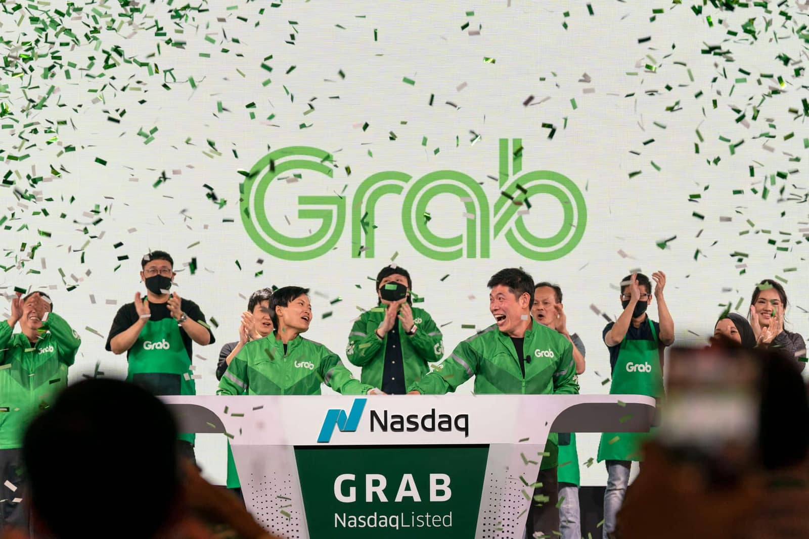

Holdings
NQ:GRAB

Slide 2
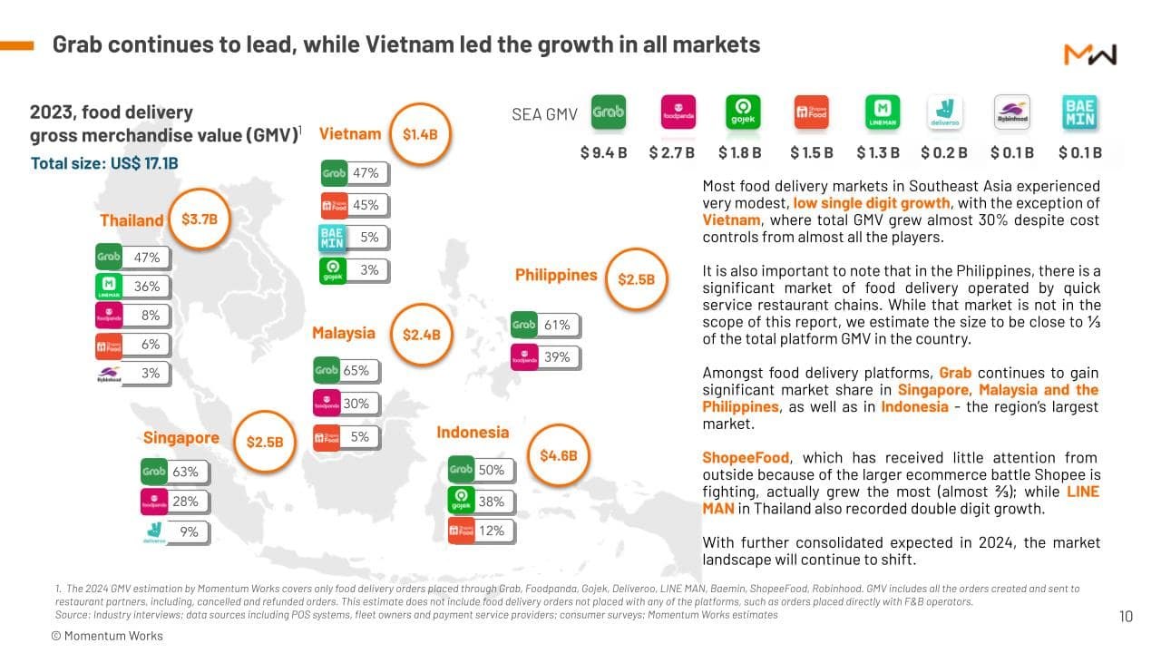

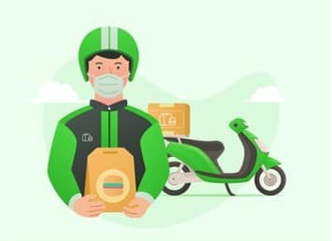
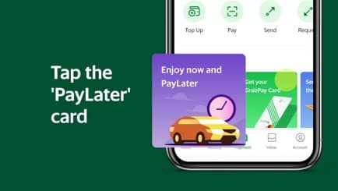
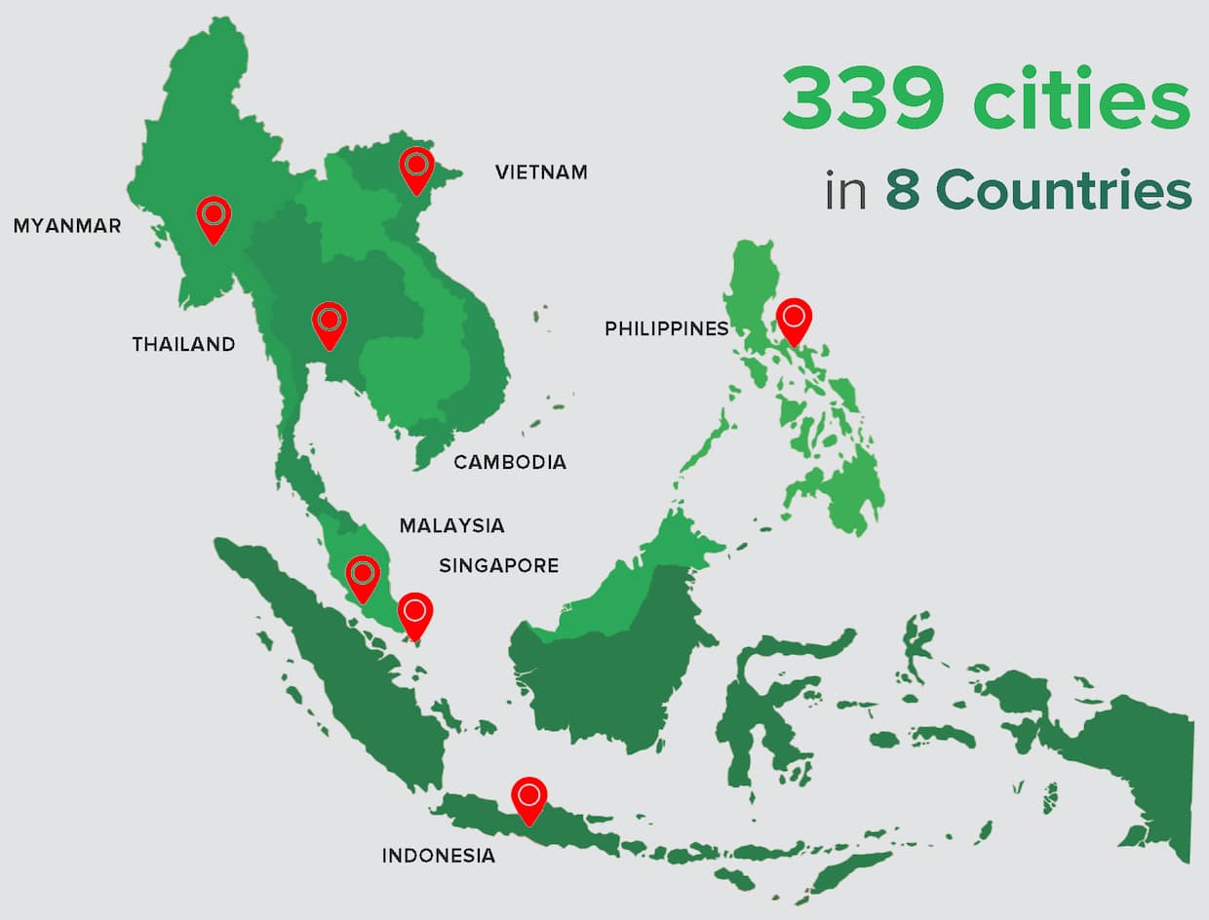
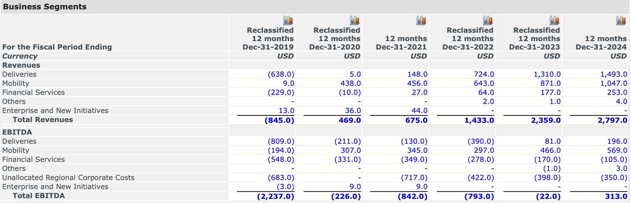


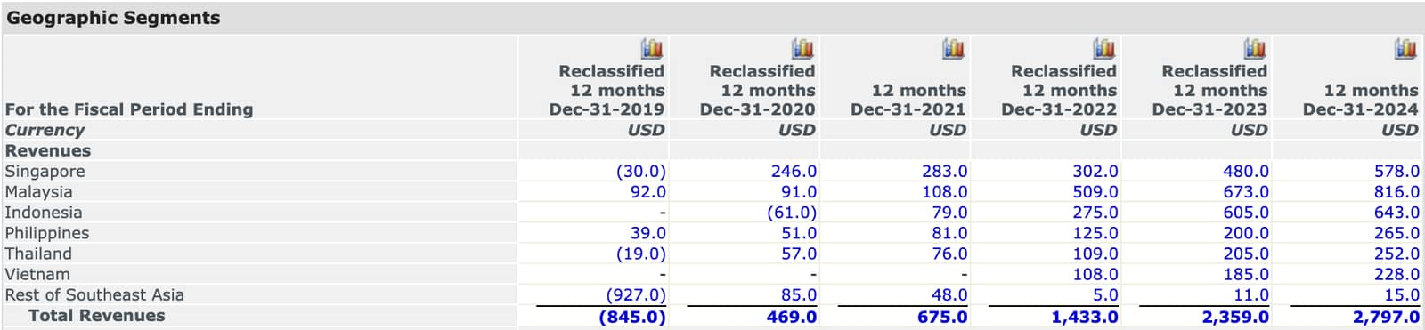

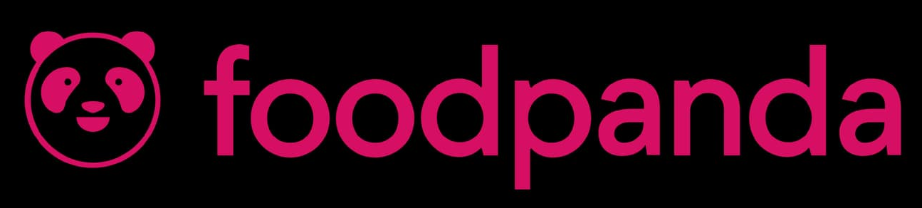
OVERVIEW
Overview
Company Overview
Grab Holdings Limited, founded in 2012
Headquartered in Singapore and operates in 8 SEA countries: Singapore, Malaysia, Cambodia, Indonesia, Myanmar, Philippines, Thailand and Vietnam
As an operator of a “super-app”, Grab is primarily considered as a technology company
Grab combines multiple service areas, mainly mobility services, delivery services and financial services
Industry Overview
Consumer trends (Macro tailwind)
SEA’s 600M+ population are mobile-first consumers
Rapid digital adoption, 450M internet users in SEA
Consumers are shifting to on-demand, app-based services
Urbanisation & rising middle class means higher disposable income
Mobility services
SEA ride-hailing projected to fetch US$9.4B revenue in 2025 with a CAGR of 6% through 2030
Market drivers: Increasing urban congestion, reduced car ownership
Takeaway: Steady growth, but lower margin versus other segments
Delivery services
SEA delivery market projected to fetch US$45.1B revenue in 2025 with a CAGR of 10.8% through 2030
High frequency use case, post-pandemic consumers still maintain habit of ordering food online
Takeaway: Largest near-term growth driver, subscription model increases stickiness
Financial services
SEA fintech market projected to surpass US$33B revenue in 2025 with a CAGR of 15-20% through 2030
70+% of adults in SEA are unbanked or underbanked, creating huge growth opportunities
GrabPay, lending, and insurance benefit from ecosystem data
Takeaway: Long-term margin expansion driver, higher profitability potential than rides/delivery
Key Rivals
Regional rival: GoTo (Gojek - Indonesia)
Global rival: Uber (United States)
Other key competitors: Delivery Hero (Foodpanda), Sea Group (ShopeePay)
Mobility services (Ride-Hailing)
Core offering: On-demand ride-hailing across 8 Southeast Asian countries
Key features: Dynamic pricing & route optimisation, GrabShare (Carpooling), Safety features (in-app driver verification, emergency assistance)
Strategic role: Anchor service that built Grab’s brand and user base
Delivery services (Food, Groceries, Logistics)
Core offering: Food delivery (GrabFood), grocery delivery, and parcel logistics
Key features: GrabUnlimited subscription (free delivery, discounts), Share saver (group orders)
Strategic role: High-frequency service that drives daily app usage
Financial services (Fintech & Digital Banking)
Core offering: Digital wallet (GrabPay), Buy-now-pay-later, lending and insurance
Key features: Customer deposits from digital bank partnerships, credit scoring and bundled financial products for users and merchants
Strategic role: Highest margin growth engine, leveraging Grab’s ecosystem data
Source(s): Capital IQ
Notes:
growth of digitql adoption or mobile penetration
grab can leverage and grow on this adoption
derscription abt delievery services
give numbers for higher profitability
be more specific in competitors

Slide 3
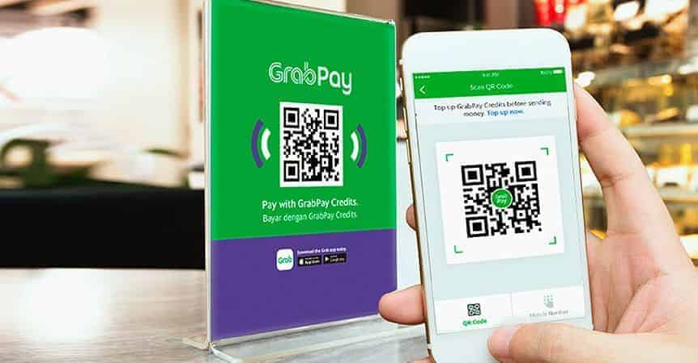
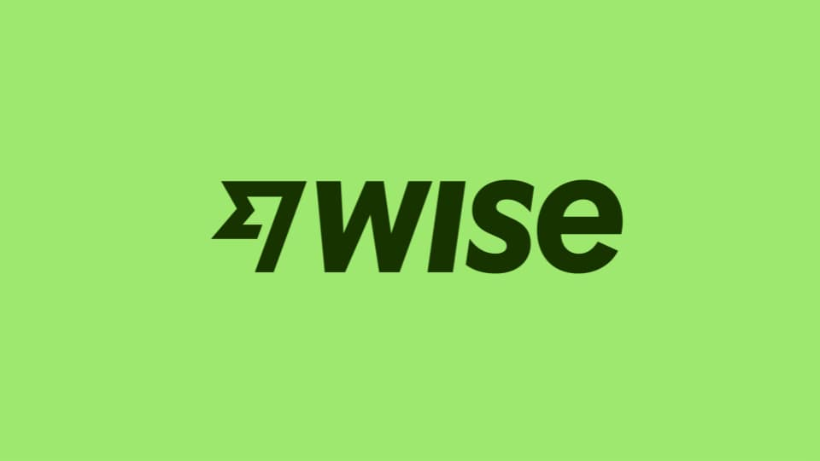

INVESTMENT THESIS
Unlocking Profitable Growth: Grab’s Fintech & AI Transformation
Fintech as the growth engine
Grab’s long-term growth will come not from expanding rides or food delivery where it already dominates but from scaling fintech (GrabPay, lending, insurance) and embedding AI personalization
These higher-margin, underleveraged services can transform Grab from a “super-app” into a fintech + AI platform, driving profitability, defensibility, and ecosystem stickiness
Market share & Underleveraged position
34M+ MTUs (Monthly Transacting Users) across SEA, mostly monetized through rides and food delivery
Personalisation still limited compared to competitors like Shopee, which use algorithms to maximise tailored offers
Opportunity: Leverage data across mobility, delivery, and payments to unlock deeper engagement and revenue
Past plans (2019-2023)
Launches: GrabPay wallet, GrabInsure, GrabFinance
Challenges: Initially slow adoption due to competitors (Touch-N-Go, ShopeePay)
Focus: Expansion beyond mobility and delivery
Catalysts
Data-driven competitive advantage
Proprietary dataset across mobility, delivery, and payments are very valuable intangible assets
AI models embedded in GrabUnlimited, GrabPay, and lending/insurance products can strengthen stickiness and create barriers to entry
Ecosystem flywheel & Monetisation
Cross-selling & bundling (rides + subscriptions, Grabpay cashback) reinforces user engagement
Self-reinforcing loop drives retention, GMV, and profitability from existing user base
Current progress (2024-2025)
Financial services revenue: US$253M (+44% YoY)
Lending portfolio: US$536M (+47% YoY), targeting SMEs & unbanked consumers
E-wallet leadership: ~24% of market share in Malaysia and growing traction in Singapore
Profitability advantage: Financial services margins 10-15% higher than rides/food delivery, but still <20% of total GMV
By paying through GrabPay, users earn points
Points earned through GrabRewards can be redeemed for discounts
Forecast (2025-2027)
Opportunities:
Cross-border remittances
SME credit scoring, potential partnerships with Wise etc.
Micro-insurance expansion
Bundled subscriptions & GrabPay cashback offers
Impact:
If fintech grows from ~9% of revenue to a higher double-digit share, overall margins for Grab could structurally improve, further pushing the path to profitability
GrabPay
GrabPoints
GrabCar / GrabFood
GrabRewards
Customer hails a ride or orders food, and make use of other services
Users redeem discounts for future purchases/rewards in partnership with merchants
Source(s):
Notes:
ÍSaver tiers have been rolled out nationwide in Singapore and Malaysia; in other countries (Indonesia, Philippines, Vietnam, etc.), availability is currently limited to key cities/certain regions. There remains opportunity for expansion into under-served locations.
What Grab Has Surpassed
Uber in Southeast Asia
In 2018, Grab acquired Uber’s SEA operations. Since then, Grab has become the dominant ride-hailing platform in Singapore, Malaysia, Philippines, and Vietnam.
Foodpanda in key delivery markets
In Singapore and Malaysia, GrabFood has overtaken Foodpanda in gross merchandise value (GMV) and market share, becoming the top food delivery player.
Local ride-hailing players
In markets like Vietnam and Thailand, Grab has outgrown smaller local apps (e.g., EasyTaxi, Lalamove in ride-hailing) through better incentives, a larger driver base, and stronger brand trust.
Payment adoption vs banks/fintech startups
GrabPay is now one of the top e-wallets in Singapore and Malaysia, surpassing many smaller standalone fintech apps by being bundled with rides and food delivery.

Slide 4
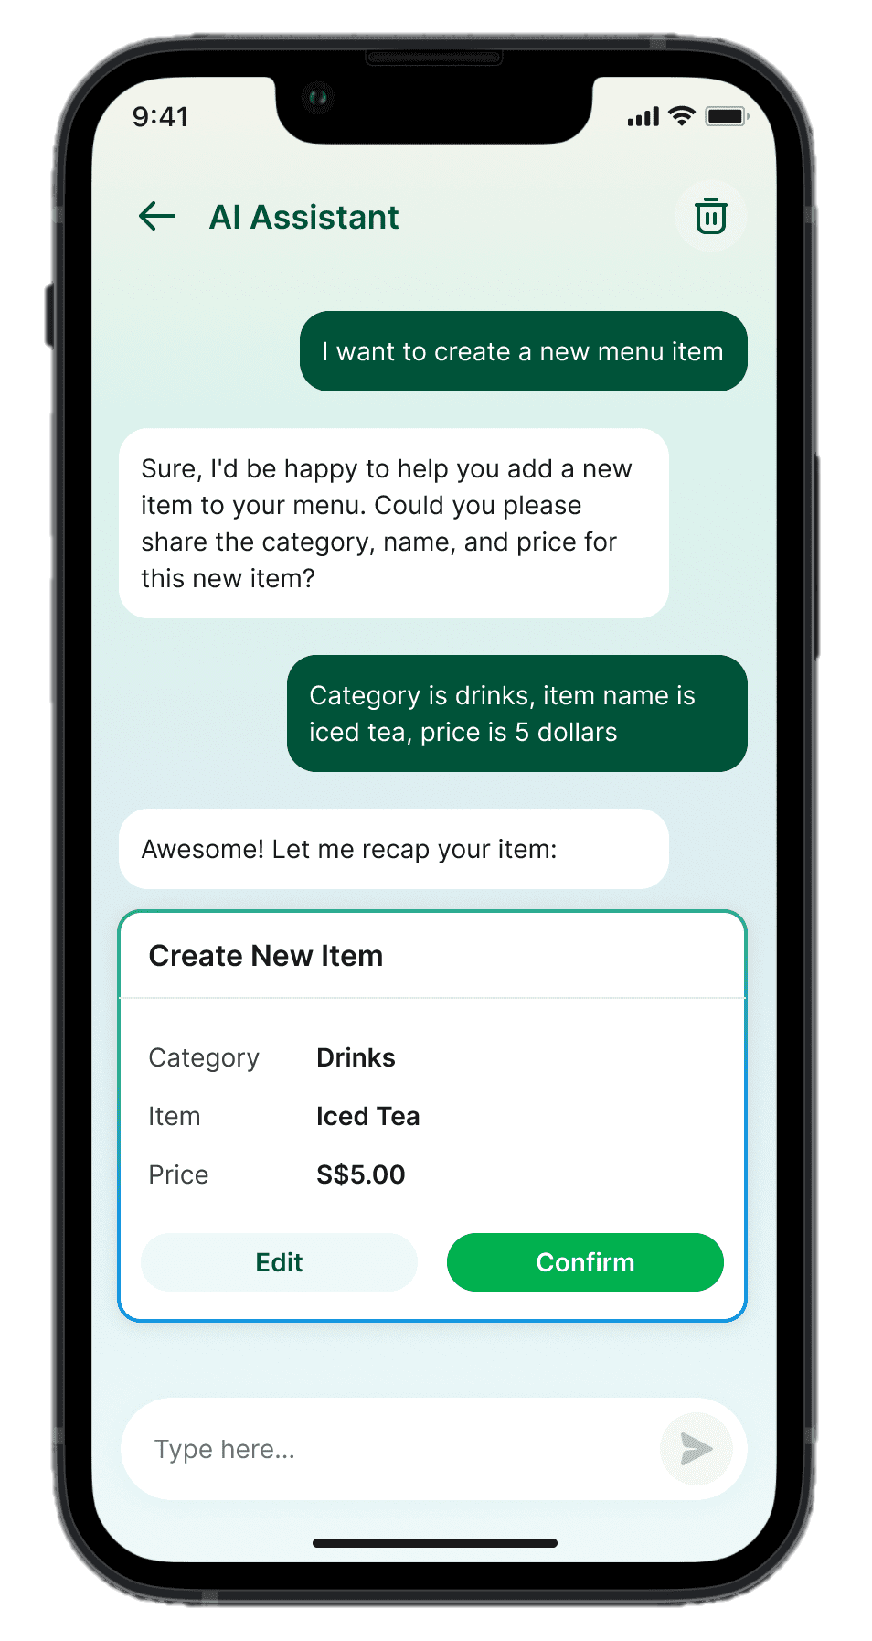
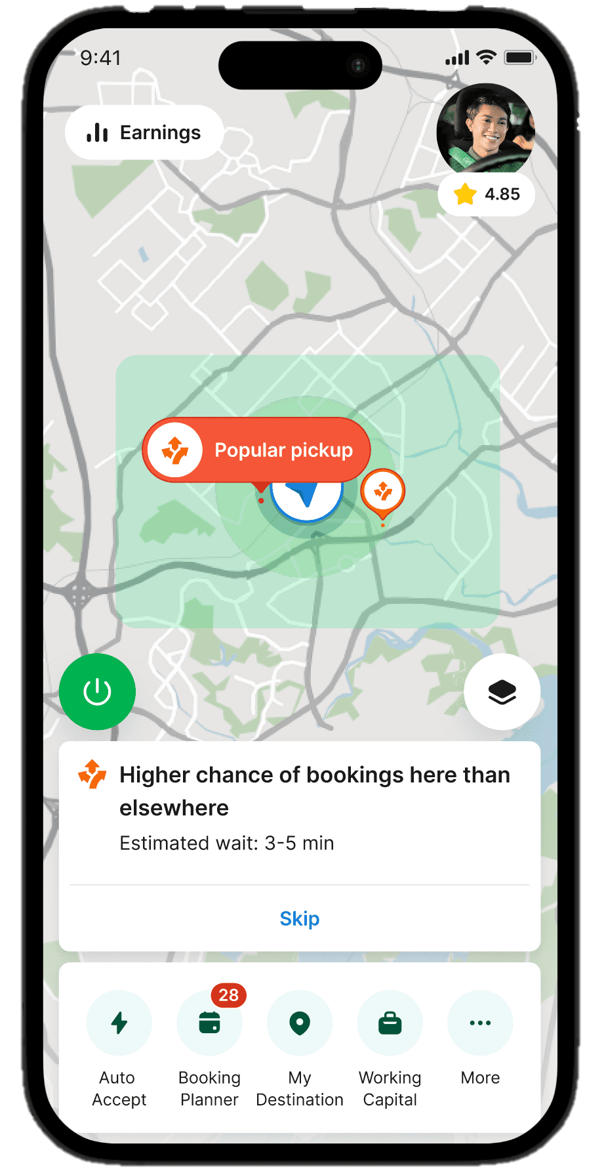
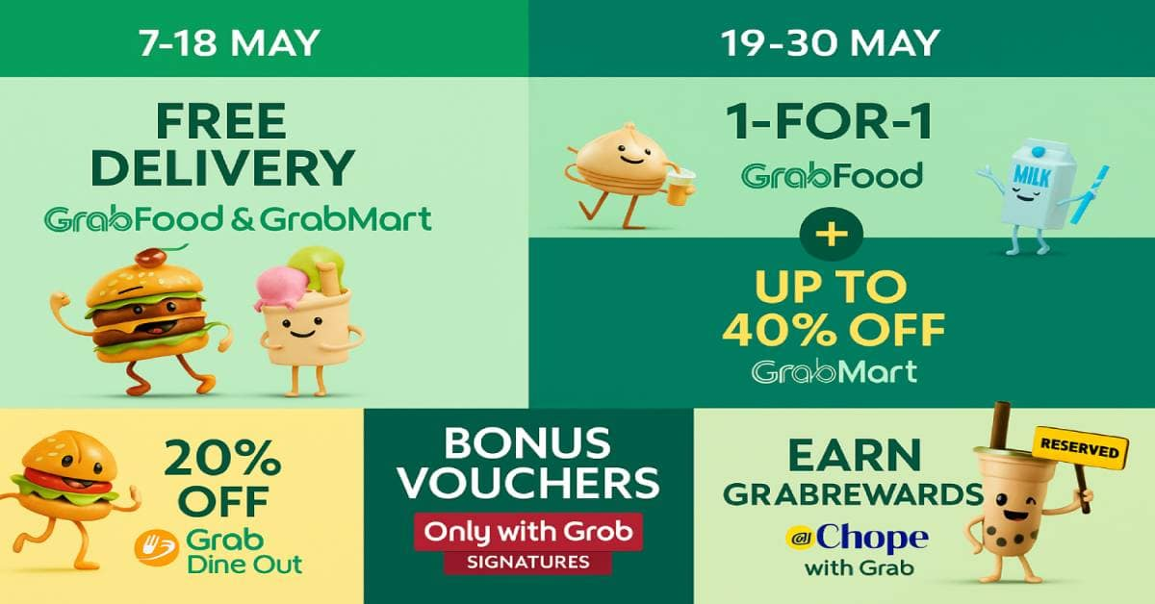
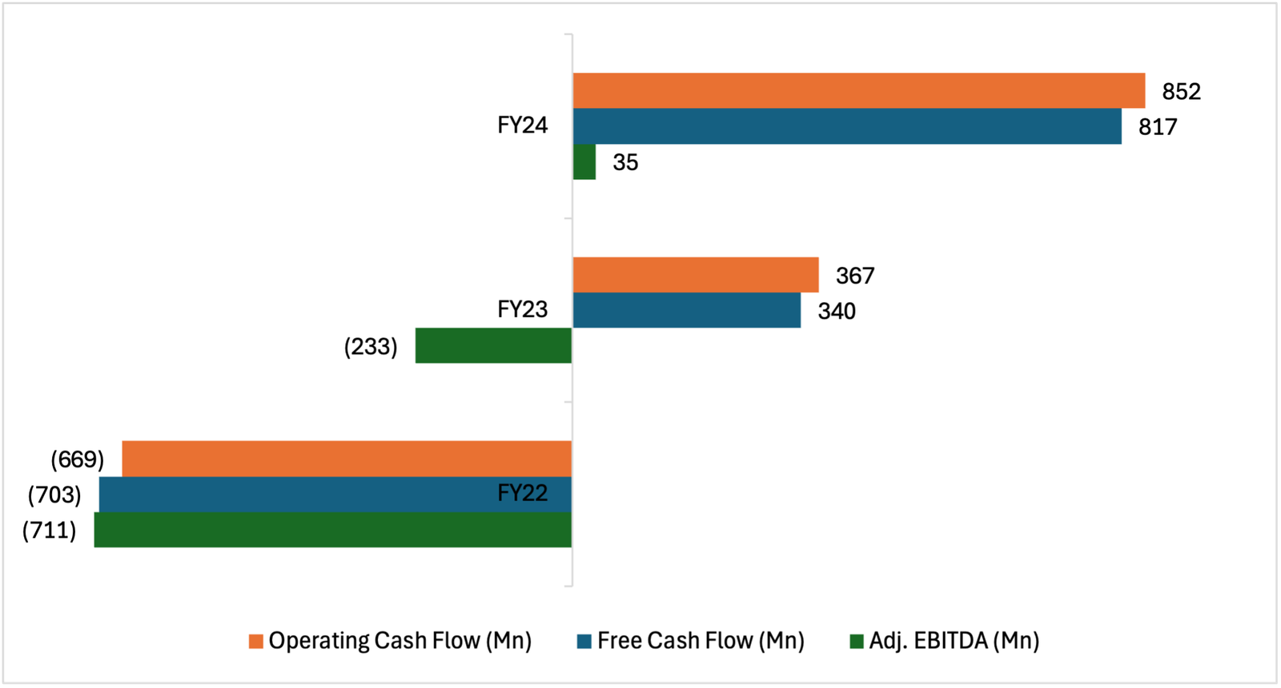
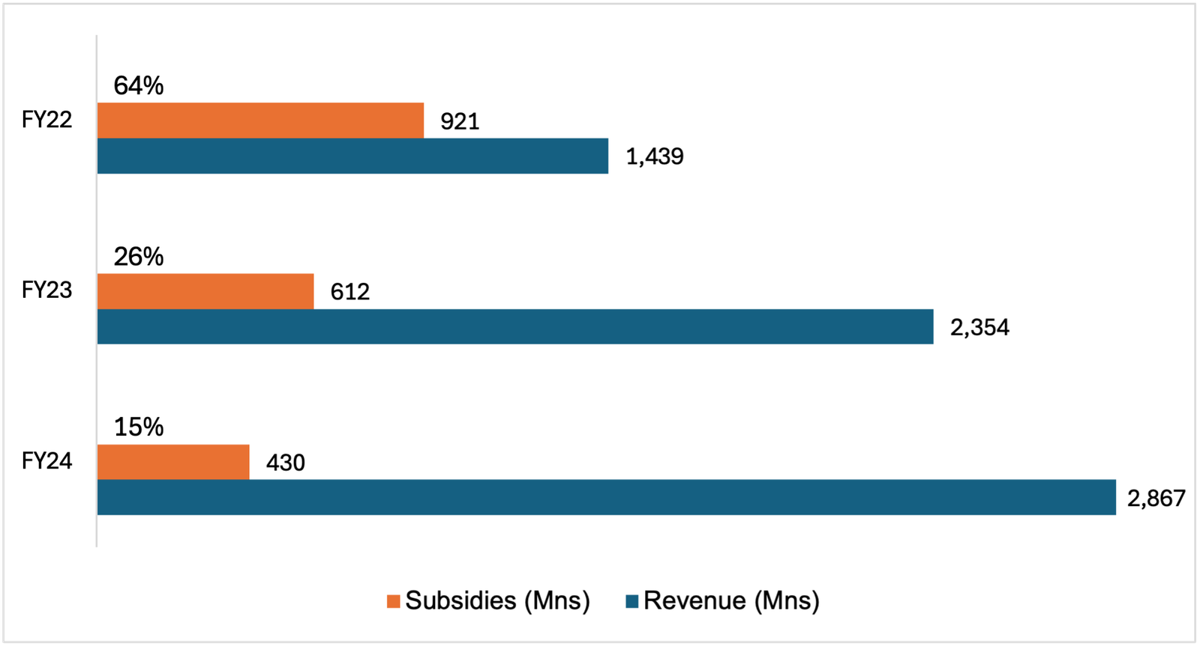
INVESTMENT THESIS
AI-Driven Efficiency & Partner Empowerment
Understanding Subsidies & Why AI Reduces Them
Ride-hailing & delivery, platforms like Grab often pay:
Driver subsidies: Incentives/bonuses to ensure drivers earn enough when demand is low.
Consumer subsidies: Discounts/promotions to attract users.
Merchant subsidies: Fee reductions or ad credits to keep restaurants on platform.
Supporting evidence & data
Driver productivity gains
AI Ride Guidance pilot (Aug 2025) boosted driver earnings/hour by +21% across >80,000 drivers in 14 SEA cities
Higher utilization = fewer idle hours; reduces need for driver incentive subsidies
Financial proof of operating leverage
Adjusted EBITDA Q2’25: US$109M (+US$89M YoY improvement)
TTM Operating Cash Flow: US$728M
Free Cash Flow: US$229M
Shows AI-driven efficiencies are already feeding into positive cash flow
Merchant efficiency & stickiness
AI Merchant Assistant automates menu updates, ad campaigns, and insights; lowers merchant workload
Improves GMV and strengthens retention, making Grab the “default platform” for SMEs
Structural subsidy decline
Almost 2/3 of revenue in FY22 but as of FY24 down to 15%, clear sign of improving efficiency and stronger natural demand
AI-driven tools could take this further, reducing subsidies to 10% or lower in the medium term, unlocking several hundred million in annual savings
Understanding Subsidies & Why AI Reduces Them
What are subsidies?
In ride-hailing & delivery, platforms like Grab often pay:
Driver subsidies: Incentives/bonuses to ensure drivers earn enough when demand is low.
Consumer subsidies: Discounts/promotions to attract users.
Merchant subsidies: Fee reductions or ad credits to keep restaurants on platform.
How AI reduces subsidies:
Driver side: If drivers earn 21% more per hour via better matching, Grab doesn’t need to artificially boost income with incentives.
Merchant side: If merchants run more efficient promotions via AI, Grab spends less on subsidizing orders.
Consumer side: Faster matches, smoother UX = higher satisfaction; less need for heavy discounts to keep users engaged.
Agentic AI tools & their impact
What it does:
Guides drivers to areas with high demand in real time, reducing idle/wait time between jobs
Impact
Higher driver earnings per hour (+21% reported in pilot)
Drivers are less reliant on incentive subsidies, Grab doesn’t need to boost income with incentives
What it does:
Predicts demand hotspots and matches drivers more efficiently to riders
Impact:
Improves order allocation; fewer cancellations, faster rides, higher utilisation
Smoother UX leads to higher satisfaction, less need for discounts to engage users
What it does:
Automates tasks like menu updates, promotional campaigns, and provides insights into customer behaviour
Impact:
Merchants get more sales with less effort; they are more inclined to advertise with Grab more and be part of their ecosystem
AI Driver Companion
AI Ride Guidance (Beta)
AI Merchant Assistant
Agentic AI Tools & their impact
AI Driver Companion
What it does: Guides drivers to areas with high demand in real time, reducing idle/wait time between jobs
Impact: Higher driver earnings per hour (+21% reported in pilot) means drivers are less reliant on incentive subsidies.
AI Ride Guidance (Beta)
What it does: Predicts demand hotspots and matches drivers more efficiently to riders
Impact: Improves order allocation; fewer cancellations, faster rides, higher utilisation. This reduces Grab’s need to “top up” driver income via subsidies, and lowers cost-per-ride
AI Merchant Assistant
What it does: Automates tasks like menu updates, promotional campaigns, and provides insights into customer behaviour
Impact: Merchants get more sales with less effort. Higher merchant retention reduces Grab’s need for discounts, promo credits to onboard/retain restaurants which are very costly
Overall: Over time, this means that AI makes the ecosystem more self-sustaining, where natural supply demand balance replaces cash burning subsidies
Overall: Over time, this means that AI makes the ecosystem more self-sustaining, where natural supply & demand balance replaces cash burning subsidies
Why Market hasn’t priced it in
Too new to be in models
Agentic tools were just announced in Apr ’25, sell-side consensus is still based on legacy assumptions of slow margin expansion
Analyst conservatism
Street still focuses on revenue growth, assumes gradual cost improvements
AI-driven subsidy cuts & productivity gains are excluded from most models
SEA execution discount
Global investors often assume slower adoption in SEA compared to US/China peers
Reality: Grab already has 80k+ drivers using AI Ride Guidance with proven 21% uplift
Legacy “Cash-burn” bias
As seen from the stock price movement (from IPO $13 - $2 lows), Grab is still viewed as a loss-making company and subsidy heavy company despite turning cash flow positive in FY24
Catalysts
Merchant monetisation
Exploring SaaS-like monetisation strategies for its AI Merchant Assistant, including premium features & advertising tools; creating new revenue streams for Grab
Government backing
Grab’s AI Centre of Excellence in SG, backed by Digital Industry SG, aims to accelerate AI-driven solutions that improve accessibility, boost productivity, and contribute to smart nation building across SEA
Investor recognition
Most recent Q2 ‘25 earnings report exceeded expectations, signalling faster margin expansion than previously anticipated, if maintained they could possibly double their forward sales multiple
Source(s): Grab Investor Relations
‹#›
Notes:
april 2025 is very misleading > priced in?
comparison w other companies that use AI tools also and if their margins improved.
how well is ai helping? use research.
grab Ai has a high potential > useful? margin comparison using structural subsidies
grab cut subsidies due to AI.
will the new ai tool outperform due to grab understanding AI better in the recent years?
how well to control margin and how well did they use ai.
grab ai is backed by government can use as base line
Core Thesis:
Grab’s rollout of agentic AI tools: the Driver Companion, AI Ride Guidance, and Merchant Assistant, represents a structural cost advantage.
By improving driver productivity and merchant efficiency, Grab can reduce reliance on subsidies, accelerate profitability, and unlock operating leverage.
Subsidies = the biggest drag on profitability in the early years.
GMV = Gross Merchandise Value

Slide 5
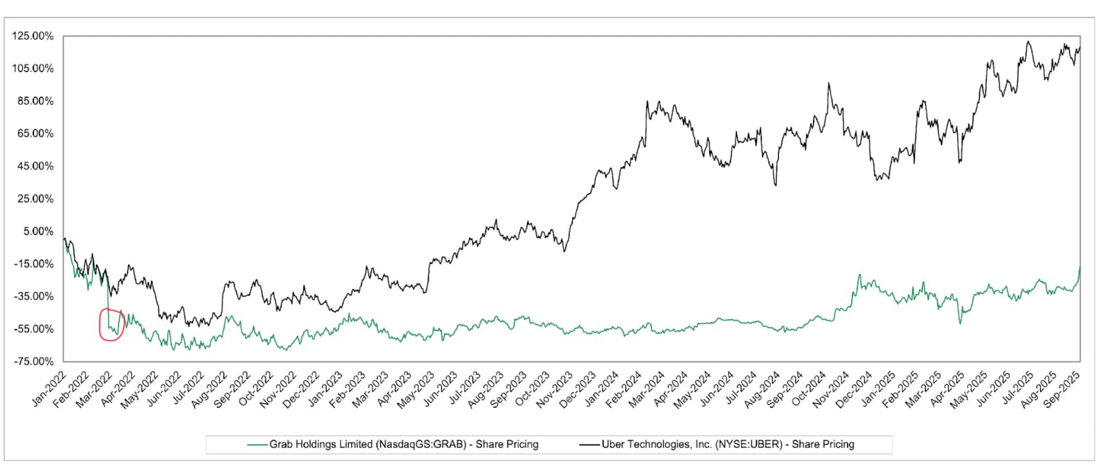
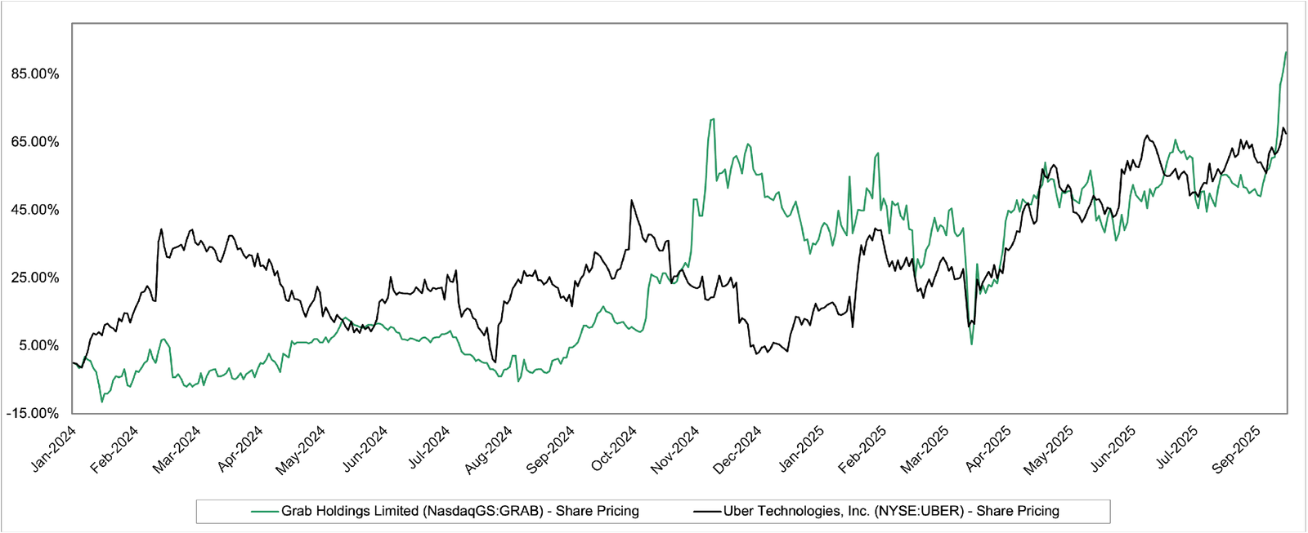
STOCK PRICE MOVEMENT
Stock Price Movement
Stock performance since IPO
IPO (Dec 2021): Grab listed on Nasdaq via SPAC merger at US$13/share
Post-IPO crash (2022): Stock fell ~80% due to heavy losses, subsidy concerns and macro tech sector selloff
Recovery path (2023-2024): Stock stabilized in the US$2-4 range as losses narrowed, and cash flow turned positive
Current (2025): Trading at US$5-6/share
Relative performance (vs UBER)
UBER IPO (2019 @ US$45/share), after years of losses, it re-rated sharply once EBITDA turned positive in 2022
Grab is now on the same profitability path as their adj. EBITDA just turned positive in FY24
Key drivers of stock movement
2021-2022 Decline: Investor skepticism post-SPAC, subsidy-heavy model coupled with the macro sell-off in the growth tech sector
2023 Stabilisation: Subsidies reduced from 64% of revenue to 26% and operating cash flow turned positive
2024-2025 Recovery: Strong cash flow numbers as well as new AI & fintech growth narrative emerging
Valuation context
Grab currently trades at 2x EV/Sales vs Uber 4x EV/Sales
Discount reflects investors skepticism; however, upside exists if profitability narrative takes hold
The key question for investors will be whether Grab will follow Uber’s re-rating path once profitability scales
Source(s): Capital IQ
Notes:
dont need compare different stocks just compare why increase/decrease using f.s
if this same thing were to happen again will grab be better or worse? main point of stock price movement
how will they consistently
A SPAC merger is when a blank-check company (a SPAC, or Special Purpose Acquisition Company) acquires or merges with an existing private company, taking the private company public without the need for a traditional IPO process

Slide 6
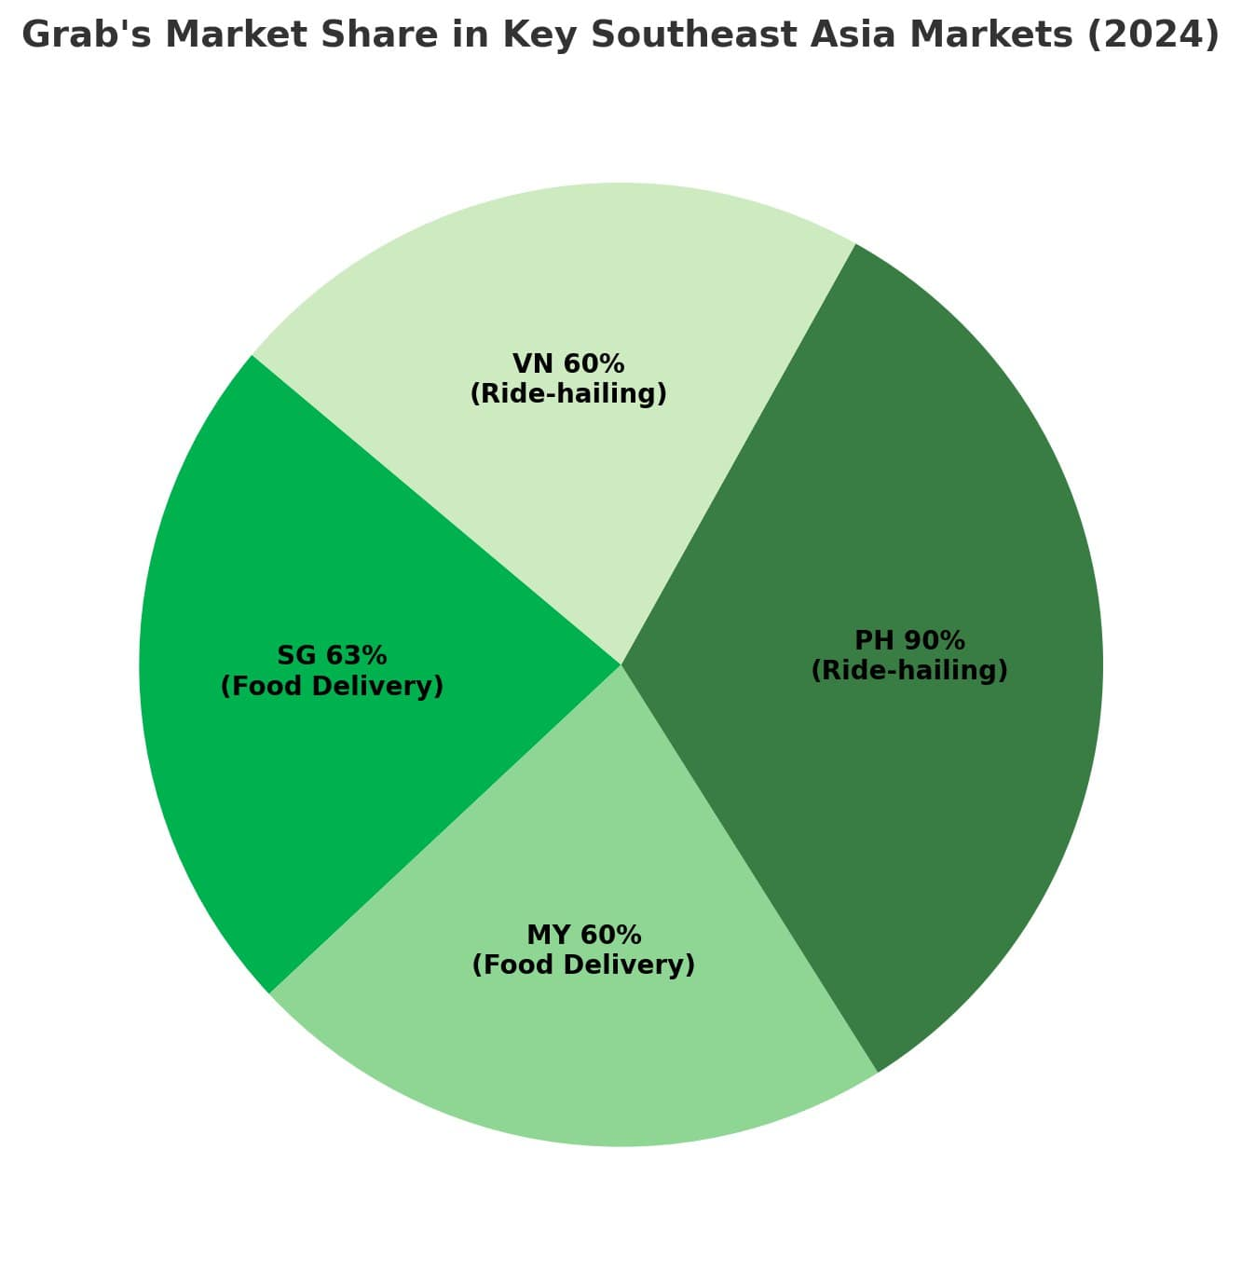
VALUATION ANALYSIS
Valuation Analysis
Valuation snapshot
Market capitalisation: ~US$12B
Net cash position: ~US$5.9B, with minimal debt
Enterprise Value (EV): ~US$6.1B
FY24 Revenue: ~US$2.8B
EV/Sales: ~2x
Price/Sales: ~4x
Discount / Premium:
Grab is currently trading at a discount relative to peers.
Uber currently trades at around 3-4x EV/Sales, Sea Group (Shopee/SeaMoney) currently trades at around 2-3x EV/Sales
Company | EV/EBITDA | Description
Uber Technologies (UBER) | 17x | Global ride-hailing and delivery leader with a similar business model, serving as a benchmark for mature-market valuation
Lyft (LYFT) | 12x | Pure-play U.S. ride-hailing peer, offering a comparison for a company with a more focused geographical footprint
Delivery Hero (DHER) | 17x | Multinational online food delivery company, reasonable food-delivery peer. Asset-light platform model and are investing heavily in vertical expansion strategies
Grab Holdings (GRAB) | 20x | Super-App/Fintech Optionality: Grab's model is a "Super-App" combining mobility, Delivery, and financial services
Valuation misalignment with improving fundamentals
Grab trades at a material discount to global peers despite delivering superior revenue growth and a clear trajectory of profitability improvement.
The company’s dominant market position in Southeast Asia, reinforced by a cash-rich balance sheet, provides both resilience and scale advantages that peers cannot replicate.
With margins already expanding and operating leverage unlocking, Grab is structurally positioned for re-rating.
The current valuation gap undervalues its growth profile and earnings power, creating a compelling opportunity for investors
Intrinsic value
To determine an intrinsic value for Grab, we applied a comparable company analysis using the forward Enterprise Value-to-EBITDA (EV/EBITDA) multiple. Based on Grab's superior growth trajectory in Southeast Asia and the premium associated with its integrated Super-App ecosystem, we believe a 20x forward EV/EBITDA is a justified premium
Implied Share Value of $6.50.
This represents a 6.46% upside over the current share price of $6.08 and validates our BUY rating
Profitable & Scaling Fast:
Q1 2025 revenue US$ 773 M (+18% YoY); Adj. EBITDA US$ 106 M (↑ 70% YoY); first net profit US$ 10 M.
Fintech Optionality:
Financial Services revenue US$ 75 M (+36% YoY); loan book +56% YoY to US$ 566 M; deposits US$ 1.43 Improving Margins:
Deliveries EBITDA = 2.0% of GMV (↑ from 1.6%); Mobility = 8.8% of GMV; fixed costs ↓ 5% YoY.
Balance-Sheet Strength:
US$ 6.2 B cash liquidity / US$ 5.9 B net cash; US$ 500 M share-buyback plan.
Source(s):
Notes:
comparables to calculate an avaerage or median to get grabs ebida
for VA
use relative , dcf

Slide 7
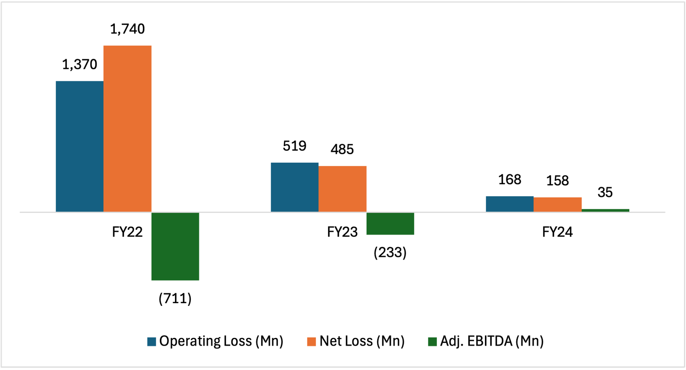
FINANCIAL ANALYSIS
Financial Analysis
Revenue Growth
Overall growth
Total revenue doubled from US$1.4B in FY22 to US$2.8B in FY24, ~39% CAGR
Mobility sector
Strong recovery post Covid, achieving consistent double-digit YoY growth from FY22-FY24
Achieved record segment revenue in FY24, benefitting from improved driver supply and reduced incentives
Key Driver: Increased demand in Indonesia, Singapore, and Vietnam as well as higher avg. fees
Delivery sector
Segment revenue growth was lower than mobility but still robust, supported by diversification into groceries and non-food verticals
Deliveries profitability improved significantly as incentives fell, and commission take-rate rose
FY23: Revenue uplift from order frequency gains and new merchant onboarding
FY24: Growth driven by GrabUnlimited subscriptions and merchant advertising
Financial Services
Currently the smallest contributor to revenue, but it is the fastest growing
FY22-FY23: Operating at losses due to heavy investment in R&D as well as promotions
FY24: Revenue grew sharply, led by payments volume expansion and digital bank traction in Singapore and Malaysia
Path to Profitability
Operating loss narrowed from US$1.4B in FY22 to US$168M in FY24
Net loss reduced by more than 90% from FY22 to FY24, from US$1.7B to US$158M
Positive adj. EBITDA in FY24, first profitability milestone
Key Drivers: Lower incentives/subsidies, Improved driver utilisation & merchant take-rates and early benefits from AI efficiency
Revenue Growth
Show FY22 → FY24 revenue CAGR (~39%).
Split by segments if possible (Mobility, Deliveries, Fintech).
Profitability Path
Operating loss narrowing: (1.37B) → (519M) → (168M).
Net loss improving: (1.74B) → (485M) → (158M).
EBITDA or Adjusted EBITDA if available.
Cash Flow
Operating cash flow:
FY22: -798M
FY23: +86M
FY24: +852M (first year of strong positive CF).
Balance Sheet Health
Cash & equivalents ~US$3B (ample runway).
Low debt relative to cash (liabilities rising due to customer deposits).
Margins & Efficiency Ratios (optional)
Gross margin, Operating margin trend.
Cash burn vs revenue.
Cash Flow & Balance Sheet Health
Operating cash flow
FY22: US$(798)M (outflow)
FY23: US$86M (turning point)
FY24: US$852M (first healthy inflow)
With US$852M of operating cash flow in FY24, that is a swing of >US$1.6B over the 3 years
Free cash flow
FY22: US$(703)M
FY23: US$340M
FY24: US$817M
With free cash flow turning strongly positive, Grab now has self-funding capacity
Balance sheet strength
Cash & cash equivalents: US$3B in FY24
Debt: Low relative to cash and there is no near-term refinancing risk
Increasing liabilities is due to rising customer deposits from growing fintech adoption, not a reflection of financial stress
Grab now has ample runway to scale AI + fintech initiatives
Margins & Efficiency
Efficiency gains and subsidy cuts are driving margin improvements, positioning Grab for sustained profitability
Gross margin has improved consistently as Grab shifted from incentive-heavy model to organic demand
Structural shift: Grab cut subsidies by >US$490M, while revenue nearly doubled
Operating margin (Loss/Revenue)
FY22: -96%
FY23: -22%
FY24: -6%
Operating margin close to breakeven in FY24, with adj. EBITDA being positive in is a very healthy indicator
Sales & Marketing as % of Revenue (Proxy for subsidies)
FY22: 64%
FY23: 26%
FY24: 15%
Benchmark
Uber was re-rated when its margins crossed into positive territory, Grab is approaching the same inflection
Source(s): Grab Investor Relations
Notes:
financials,ebitda,revenue use graph or tables too wordy
show key ratios or margin to tell people grab is not overly leveraged or grab is not doing so well but slowly become profitable.
Grab has transitioned from heavy cash burn to generating strong positive operating cash flow, backed by a robust balance sheet with ample liquidity

Slide 8
RISKS & MITIGATIONS
Risks & Mitigations
Competition & Market share pressure
Risk
Grab operates in highly competitive sectors (Mobility, Delivery, Fintech)
Rivals like GoTo (Indonesia), Delivery Hero (Foodpanda), and Sea Ltd (ShopeePay) aggressively compete on price, promotions, and subsidies
If competition intensifies, Grab may need to reintroduce heavy subsidies – thus pressurising margins and delaying profitability
Mitigation
Scale leadership: Compared to rivals in SEA Grab has secured ~55% GMV market share in food delivery and it is the leading mobility platform across multiple countries as well
Ecosystem bundling: GrabUnlimited subscriptions and cross-service discounts increases stickiness, and this reduces churn risk
New AI-driven efficiencies further lowers operating costs, allowing Grab to remain competitive without returning to subsidy-heavy strategies
AI Hype & Competitive catch-up
Risk
Current enthusiasm for AI could prove over-hyped if the tools fail to deliver sustained cost savings or adoption at scale
While Grab has an early-mover advantage, competitors are likely to adopt similar AI tools over time
If AI becomes commoditised, Grab’s margin advantage could erode, weakening one of its key differentiators
Mitigation
Grab’s proprietary SEA data advantage gives it a structural edge – AI models trained on localised data will outperform generic/global models
Ecosystem bundling (AI embedded across rides, deliveries, and fintech) creates deeper network effects than standalone AI adoption by competitors
Grab is investing in long-term AI infrastructure (Singapore HQ, AI Centre of excellence), showing commitment beyond the short-term “AI buzz”
Competition & Margin Pressure
Mitigants: Grab can cut costs by using AI and data to make rides and deliveries more efficient. It should focus on growing higher-margin areas like digital payments, lending, and advertising so it’s not stuck in price wars. Loyalty programs and bundles (like GrabUnlimited) keep customers coming back without heavy subsidies.
Execution Risk
Risk: Fintech is only ~9% of revenue today (US$253M FY2024). Scaling without profit discipline could mirror past subsidy-heavy delivery model.
Mitigation:
Focus on high-adoption markets (MY, SG, ID).
Prioritize profitable products (SME lending, insurance fees).
Maintain incentive discipline (consumer incentives already cut -22% YoY in 2023).
By prioritizing SME loans, micro-insurance, and merchant payments, Grab earns real, sustainable profit instead of chasing just user growth.
Execution risk in AI & fintech
Risk
Grab’s investment theses hinge on AI efficiencies and fintech adoption
If driver/merchant adoption of AI tools is slow, or fintech products (GrabPay) underperform, revenue diversification may stall
AI and fintech scaling comes with high upfront R&D and marketing costs, risking margin dilution if uptake lags as well
Mitigation
Early traction data is strong, AI Ride Guidance showed 21% increase in driver earnings/hour across 80k drivers and GrabPay processed US$5B transactions in 2024 which is a 60% growth from prior year
Strategically target profitable products as well as high adoption markets (e.g., Singapore)
Grab’s US$3B cash reserves give it capacity to absorb R&D costs while scaling AI and fintech
Grab takes a phased rollout approach (pilots before full launch), reducing large scale failure risk
Regulatory & Compliance risks
Risk
Expansion into financial services exposes Grab to stricter oversight (digital banking, lending, insurance)
Different countries have fragmented regulatory regimes which can lead to costly compliance and the risk of fine/operational delays
Implementation of AI tools may face data privacy and ethical regulation hurdles
Mitigation
Grab has a compliance-first strategy, with partnerships across governments (e.g., Singapore’s MAS and Malaysia’s bank Negara)
Operates digital banking via joint ventures with licensed partners, spreading regulatory responsibility, leveraging on existing processes that have passed regulatory checks as well as reducing their individual exposure
Grab’s brand reputation & government ties (Singapore HQ, AI Centre of excellence backed by Digital Industry Singapore) give it stronger credibility than other competitors
AI Overhype Risk
Risk: If all rivals adopt AI, Grab’s AI pivot looks generic.
Mitigation:
Cross-vertical AI: rides + food + payments → more personalised and unique
Operational AI: fraud checks, driver routing, support bot(customer service).
Region-specific AI IP (e.g. festivals /payday demand cycles). -> high demand
- Adjust driver incentives for late-night mobility surges.
- Promote BNPL for festive shopping
- predict demand for family ride clusters and gifting deliveries.
- Anticipate high ride demand for travel & nightlife.
- trigger BNPL/credit offers right after salary credit
Source(s):
Notes:
understand key potential risk and not just current risk.
put severity of the risks

